Slide 1
Application Programming Interface (API)
An API is a software intermediary that allows two or more applications to talk to each other.
Private API: It can used within the organization
Partner API: It can be used within the business partner
Public API: It can be used any third party developers
Web API: An API which interface for web is called web API
Note: JSON Data, XML Data [Data Format]

Slide 2
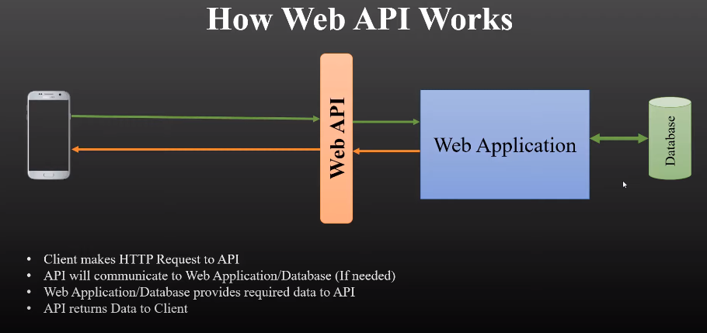

Slide 3
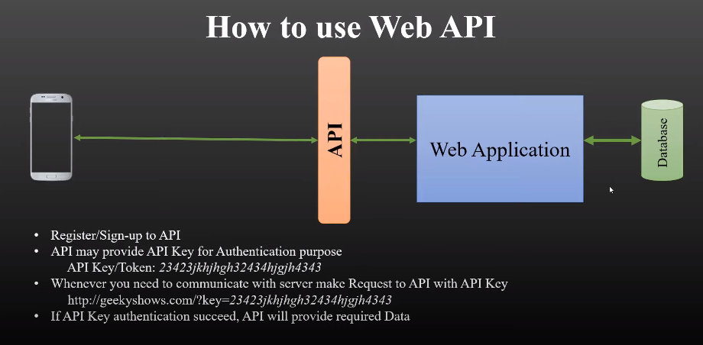

Slide 4
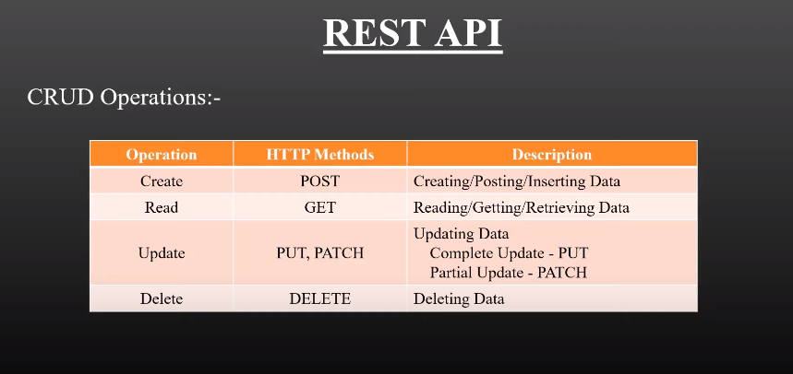
REST
It is an architectural guideline to develop Web API.
The which is developed using REST is known as REST API / RESTful API

Slide 5
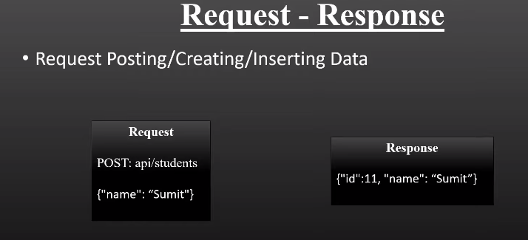
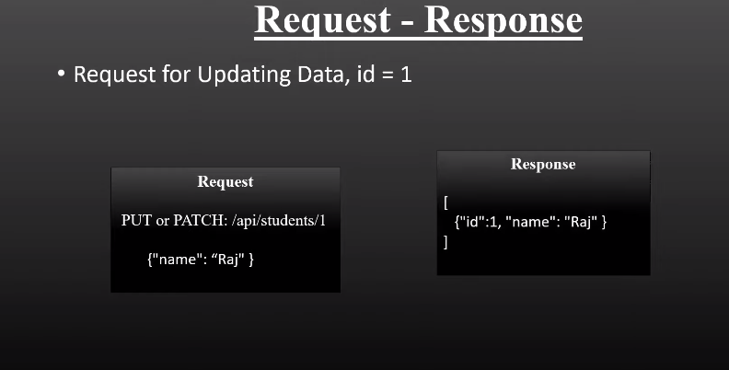
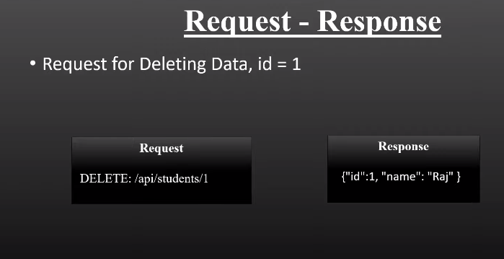
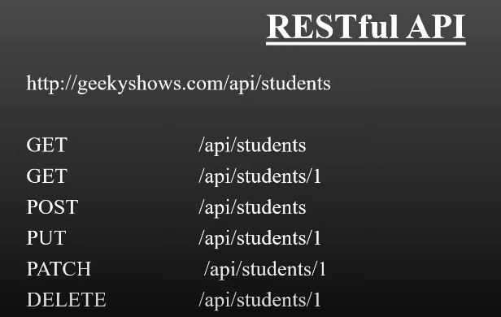
RESQUEST-RESPONSE
REST

Slide 6
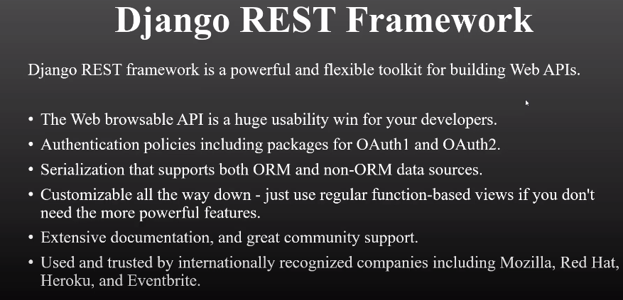
Django REST Framework

Slide 7
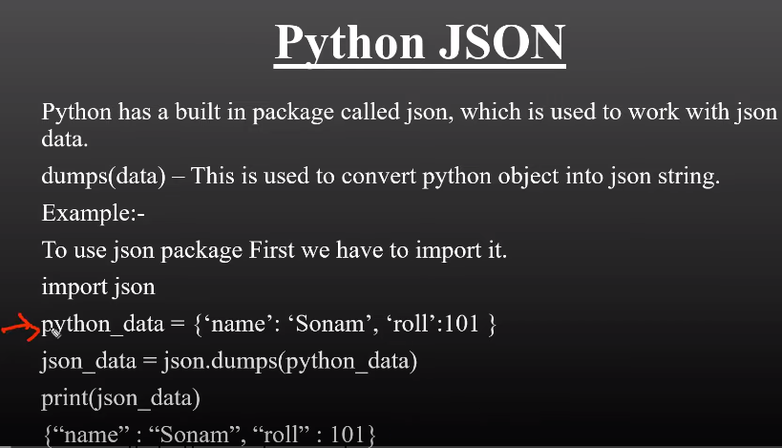

Slide 8
